Slide 1
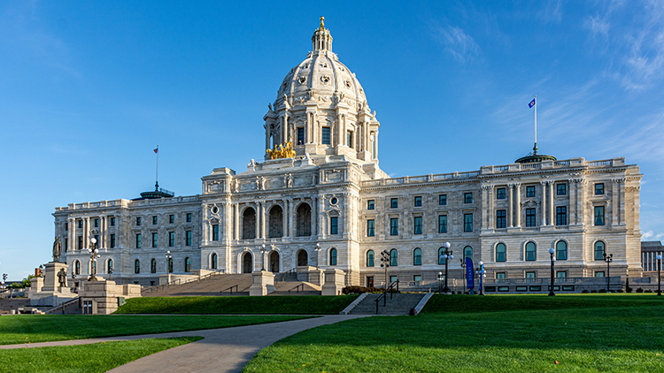
Child Care Legislation- 2024 session as of 5/10/2024

Slide 2
Overview as of 5/10
Bills with Conference Committee members named and holding meetings:
Omnibus E-12 bill
Omnibus Jobs/Workforce Development bill
Bills passed in both bodies; awaiting naming of conferees
Omnibus HHS bill
Omnibus Agriculture bill
Bills yet to be passed in one body:
Omnibus Children and Families bill (passed in the House; awaiting a Senate floor vote)
Omnibus Higher Education bill (passed in the House; awaiting a Senate floor vote)

Slide 3
House Omnibus Children and Families bill- HF 2476 Senate Omnibus Health & Human Services bill- SF 4699
HF 2476 passed the House floor 5/1 on a vote of 68-62- on Senate General Orders
SF 4699 passed the Senate floor 5/3 on a vote of 34-31 and the House floor on 5/9 on a vote of 68-59; Awaiting conference committee
HF3826 (Keeler)/SF 4341(Kupec)- Provides more funding to support access to the Child Development Associate certificate (CDA)
Included in House bill at $360,000 and the Senate bill at $500,000. Both are one-time funds.
HF 367 (Freiberg)/SF 610 (Boldon)- Child care centers and family child care providers are allowed to adopt policies regarding immunizations.
HF 367 had a second reading on the floor 3/25/24. Included in the Senate bill
Office of the Family Child Care Ombudsperson. Funding to support providers with licensing, compliance, and other needs.
Included in the House bill at $350,000 for FY 2025 in one-time funds and the Senate bill at $350,000 per year/$700,000 biennium ongoing
Weighted Risk System for Licensed Child Care. Ongoing funding to support the implementation of a tiered weighted risk system (WRS) to evaluate licensing compliance for child care centers and family child care providers.
Transition to New Department of Children, Youth, and Families. Ongoing funding for the Minnesota Department of Education (MDE) and the Minnesota Department of Human Services to maintain its current level of service after identified existing staff and resources transition to the new Department of Children, Youth, and Families (DCYF)

Slide 4
Office of Inspector General (Licensing)- in HHS bill
Technical changes to Office of Inspector General (licensing) statutes:
Use of a signature-verified confirmed delivery method for correspondence (not just certified mail)
Addition of e-mail addresses as public data
Confidentiality protection for those who bring forward claims of fraud
Clarifies the appeals process in cases involving the accusation of fraud
Allows parents to bring home and wash water bottles used at the child care program
Makes several changes/additions to certified license-exempt center statute:
Adds authorized agent in a license-exempt, certified center to the list of background check recipients
Defines requirements for certified centers in the absence of the Director
Defines age ranges for children by group (infant, toddler, pre-school, school age)
Adds a conditional certification and process for reconsideration
Adds language about required record keeping

Slide 5
Omnibus Health & Human Services bill only
SF 4170 (Boldon)-Provides an additional $1 million in funding for early childhood mental health consultation for child care providers
Included in the Senate bill at $1 million in one-time funds.
SF 3737 (Kupec)—This would continue the Child Care Facility Revitalization Grants program
Included in the Senate bill at $500,000 in one-time funds

Slide 6
Omnibus E-12 bill- HF 5237
HF 5237 Conferees: Youakim, Clardy, Edelson, Sencer-Mura, Kresha
SF 5252 (now HF 5237)- Conferees: Kunesh; Cwodzinski; Gustafson; Maye Quade; Boldon
HF 4176 (Perez-Vega)-Merges the school readiness plus program into the VPK program
Modifies the program requirements, including requiring that VPK teachers are licensed
Children must meet at least one specified criterion to be eligible to participate in the program free of charge
Splits the Minneapolis and St. Paul school districts into two separate groups for funding purposes
Ensures that any school sites that received seats in FY 2024 will receive the same number of seats in the future
HF 4176 passed the House floor on a vote of 69-61 and was sent to the Senate.
Included in the Senate E-12 Omnibus bill.
Voluntary Prekindergarten (VPK) Reserve Allocation. The Governor recommends allocating $42.1 million from the voluntary prekindergarten (VPK) reserve to provide an additional 5,200 VPK seats in fiscal year 2025
Head Start Administrative Support. The Governor recommends allowing up to two percent of Head Start funds appropriated to be used for state-level program administration and funding distribution support

Slide 7
Senate Omnibus E-12 only
SF 3922 (May-Quade)-Allows a school district to offer a preschool care program for the portion of the day a child is not enrolled in a school-based preschool program if the district also provides to children 33 months or older either a licensed child care program or preschool programming. Effective for revenue for fiscal year 2026 and later.
ALSO- Language being offered to align the Great Start Scholarship program with the upcoming rule changes for Child Care Assistance.

Slide 8
Omnibus Higher Education bill- HF 5299
HF 5299- Passed the House Floor on 5/7 on a vote of 69-58
SF 5326 (now HF 5299)-awaiting a floor vote
HF3887 (Coulter)/SF 3806 (Kupec)- Provides funds to the Board of Trustees of the Minnesota State Colleges and Universities to partner with the National Head Start Association and the Association of Community College Trustees to establish Head Start centers on college campuses.
Included in the House Higher Education Omnibus bill and the Senate Higher Education Omnibus bill at $500,000 in one-time funding.

Slide 9
Omnibus Jobs/Workforce Development- HF 5289
HF 5205 (now SF 5289)-Conferees: Hassan; Xiong; Zeleznikar
SF 5289- Conferees: Champion; Mohamed; Gustafson
HF 4943 (Kotyza-Witthuhn)- funds an additional grant to WomenVenture for their work with child care
Included in the House Workforce Development Omnibus bill at $1 million in one-time funds
S.F. 5218 (Putnam)-Child care business management solutions vendor contract with the Commissioner of Employment and Economic Development.
Included in the Senate Jobs Omnibus bill for $1 million in one-time funds.

Slide 10
Omnibus Agriculture bill- SF 4942
HF 4975 (now SF 4942)- Passed the House floor 68-59 on 5/9. Awaiting conferees
SF 4249-Passed the Senate floor 5/6 on a vote of 36-30. Awaiting conferees
HF 4163 (Norris) /SF 3528 (Gustafson) —Modify farm-to-school program requirements to include child care facilities. This will provide increased access to food and the purchase of equipment and agricultural products.
Included in the House and Senate Agriculture and Rural Policy Omnibus bill. House allocation is for $1.3m in 2025, including early education and schools; Senate allocation is $100,000 specifically for early childhood education settings, including child care centers and family child care homes.

Slide 11
Next Steps
Conference Committees formed to work out differences in the House and Senate bills
Reports from the conference committees will come back to the House and Senate floor for final votes.
May 20, 2024, is the last day of the Legislative session as outlined in the constitution
Bills passed up through the final day are sent to the Governor for approval or veto
June 30, 2024, is the last day of Fiscal Year 2024 (the first year of the biennial budget). New “one-time funds” allocated would be available from July 1, 2024-June 30, 2025, unless specified.
Since the budget for FY 2025 is already set, no budget action would be needed this session.

