Slide 1
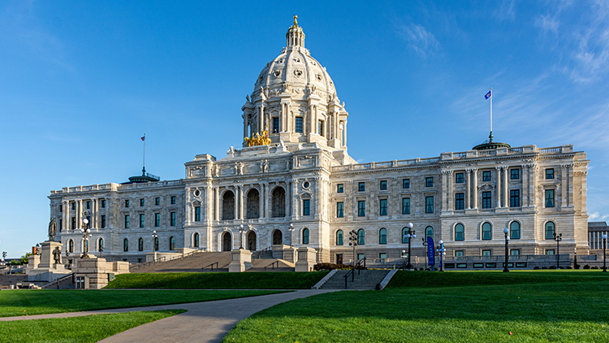
Child Care Legislation- 2024 session as of 4/19/24

Slide 2
Omnibus bills for 2024 with child care/early ed elements
House Children & Families- HF 2476 (Pinto)
House Health- HF 4571 (Liebling)
Senate HHS-SF 4699 (Wiklund)
House E-12-HF 5237-(Youakim)
Senate E-12 - SF 5252 (Kunesh)
House Higher Ed-HF 5299 (Pelowski)
Senate Higher Ed-SF 5326 (Fateh)
House Agriculture & Rural Policy-HF 3763 (Vang)
Senate Agriculture & Rural Policy-SF 3955 (Putnam)
House Workforce Development- HF 5205 (Xiong)
Senate Jobs- SF 5289 (Champion)

Slide 3
Access to Child Care
HF 3681(Kotyza-Witthuhn)/SF 3790 (Hauschild)- builds on the “Great Start Scholarship” framework that passed in 2023. It calls for Minnesota to create a way to support parents’ access by ensuring that no family pays more than 7% of their income on child care costs.
  No funding was included in the House Children and Families or Senate HHS omnibus bills, but some language to align scholarship policy with newly required federal CCDF policy (CCAP) was included.

Slide 4
Child Care Workforce Support
HF3699 (Lee, K.)/ SF 3737 (Kupec)—This would continue the Child Care Facility Revitalization Grants program
  Included in the Senate HHS Omnibus bill at $500,000 in one-time funds
HF3826 (Keeler)/SF 4341(Kupec)- Provides more funding to support access to the Child Development Associate certificate (CDA)
  Included in House Children and Families Omnibus bill at $360,000 and the Senate HHS Omnibus bill at $500,000. Both are one-time funds.
HF 4943 (Kotyza-Witthuhn)- funds an additional grant to WomenVenture for their work with child care
  Included in the House Workforce Development Omnibus bill at $1 million in one-time funds
SF 4170 (Boldon)-Provides an additional $1 million in funding for early childhood mental health consultation for child care providers
  Included in the Senate HHS Omnibus bill at $1 million in one-time funds.

Slide 5
Other Child Care related Bills
HF4425 (Hemmingsen-Jaeger)/SF 4499 (Mitchell)- A private entity (HOA-controlled communities, condo associations, etc.) must not prohibit or refuse to permit the dwelling owner from providing child care under a family and group family child care provider license
  HF 4425 Was passed and sent to the General Register. Second reading 4/2/24.
  SF 4499 Was heard and laid over for consideration in the Senate Judiciary Omnibus bill, but not included.
HF 367 (Freiberg)/SF 610 (Boldon)- Child care centers and family child care providers are allowed to adopt policies regarding immunizations.
  HF 367 was passed by the Children and Families Committee and referred to the General Register. Second reading 3/25/24.
  SF 610 is Included in the Senate HHS Omnibus bill.
S.F. 5218 Putnam-Child care business management solutions vendor contract with the Commissioner of Employment and Economic Development.
  Included in the Senate Jobs Omnibus bill for $1 million in one-time funds.

Slide 6
E-12 Bills
HF 3721 (Coulter)/SF 3922 (May-Quade)-Allows a school district to offer a preschool care program for the portion of the day a child is not enrolled in a school-based preschool program if the district also provides to children 33 months or older either a licensed child care program or preschool programming. Effective for revenue for fiscal year 2026 and later.
    Included in the Senate E-12 Omnibus bill
HF 4176 (Perez-Vega)-Merges the school readiness plus program into the VPK program
  Modifies the program requirements, including requiring that VPK teachers are licensed
  Children must meet at least one specified criterion to be eligible to participate in the program free of charge
  Splits the Minneapolis and St. Paul school districts into two separate groups for funding purposes
  Ensures that any school sites that received seats in FY 2024 will receive the same number of seats in the future
    HF 4176 passed the House floor on a vote of 69-61 and was sent to the Senate. Senate referred it to the Education Policy Committee
    Was Included in the Senate E-12 Omnibus bill.

Slide 7
Higher Education Bills
HF3887 (Coulter)/SF 3806 (Kupec)- Provides funds to the Board of Trustees of the Minnesota State Colleges and Universities to partner with the National Head Start Association and the Association of Community College Trustees to establish Head Start centers on college campuses.
  Included in the House Higher Education Omnibus bill and the Senate Higher Education Omnibus bill at $500,000 in one-time funding.

Slide 8
Agriculture Bills
HF 4163 (Norris) /SF 3528 (Gustafson) —Modify farm-to-school program requirements to include child care facilities. This will provide increased access to food and the purchase of equipment and agricultural products.
  Included in the House and Senate Agriculture and Rural Policy Omnibus bill. House allocation is for $1.3m in 2025, including early education and schools; Senate allocation is $100,000 specifically for early childhood education settings, including child care centers and family child care homes.

Slide 9
Governor’s supplemental budget bill elements- overview
Voluntary Prekindergarten (VPK) Reserve Allocation. The Governor recommends allocating $42.1 million from the voluntary prekindergarten (VPK) reserve to provide an additional 5,200 VPK seats in fiscal year 2025
  Included in the House Children and Families and E-12 Education Omnibus bills and the Senate E-12 Education Omnibus bill.
Head Start Administrative Support. The Governor recommends allowing up to two percent of Head Start funds appropriated to be used for state-level program administration and funding distribution support
  Included in the House Children and Families Omnibus and E-12 Education bills and the Senate E-12 Education Omnibus bill.
Office of the Family Child Care Ombudsperson. The Governor recommends ongoing funding for the state agency. The Office will support providers with licensing, compliance, and other needs of family child care providers. The current Office operates with one-time child care development federal funds allocated to the Department of Human Services that expire in September 2024
  Included in the House Children and Families Omnibus bill at $350,000 for FY 2025 in one-time funds and the Senate HHS Omnibus bill at $350,000 per year/$700,000 biennium ongoing

Slide 10
Governor’s supplemental budget bills-continued
Weighted Risk System for Licensed Child Care. The Governor recommends ongoing funding to support the implementation of a tiered weighted risk system (WRS) to evaluate licensing compliance for child care centers and family child care providers. This would replace Minnesota’s child care fix-it tickets. The new WRS would tier regulation violations by risk level and would ensure that resources are prioritized for child care providers who are most in need of assistance and support. Child care licensing will transfer to the Department of Children, Youth, and Families (DCYF) on July 1, 2025
  Included in the House Omnibus Children and Families bill and the Senate HHS Omnibus bill.
Transition to New Department of Children, Youth, and Families
The Governor recommends ongoing funding for the Minnesota Department of Education (MDE) and the Minnesota Department of Human Services to maintain its current level of service after identified existing staff and resources transition to the new Department of Children, Youth, and Families (DCYF)
The Governor also recommends ongoing funding to establish the operating budget for the new Department of Children, Youth, and Families (DCYF).
  Included in the House Omnibus Children and Families bill and the Senate HHS omnibus bill.

Slide 11
Department Office of Inspector General (Licensing)
Technical changes to Office of Inspector General (licensing) statutes:
  Use of a signature-verified confirmed delivery method for correspondence (not just certified mail)
  Addition of e-mail addresses as public data
  Confidentiality protection for those who bring forward claims of fraud
  Clarifies the appeals process in cases involving the accusation of fraud
  Allows parents to bring home and wash water bottles used at the child care program
  Makes several changes/additions to certified license-exempt center statute:
    Adds authorized agent in a license-exempt, certified center to the list of background check recipients
    Defines requirements for certified centers in the absence of the Director
    Defines age ranges for children by group (infant, toddler, pre-school, school age)
    Adds a conditional certification and process for reconsideration
    Adds language about required record keeping
  Elements included in the House Health bill and in HF 4537, which received a second reading on the House floor on 4/11/24.
  Included in the Senate HHS bill

Slide 12

Looking ahead to end of session

Slide 13
Next Steps
The Legislature will be in recess for Passover from Monday, April 22, through noon on Wednesday, April 24
After this recess, bills will be heard on the House and Senate floors, and conference committees will make decisions about items that are not aligned.
Reports from the conference committees will come back to the House and Senate floor for final votes.
May 20, 2024, is the last day of the Legislative session as outlined in the constitution
June 30, 2024, is the last day of Fiscal Year 2024 (the first year of the biennial budget). New “one-time funds” would be available from July 1, 2024-June 30, 2025, unless specified.

